Slide 1


MELOS CONSULTING
2024 LEARNING MENU & OFFERINGS
+234 (0) 901 987 9308, +234 (0) 803 473 6690 +234 (0) 809 997 2003
meloventuresltd@gmail.com

Slide 2

MELOS CONSULTING
At Melos Consulting, we are dedicated to inspiring quality in all aspects of learning, service delivery, and designing bespoke offerings that meet the needs of our clients who cut across different sectors such FMCG, banking, construction amongst others.
We take pride in providing a transformational learning experience focused on producing top-class talents who are in different cadres in their career journey from entry level to executive leadership levels
We have on our team, industry and subject matter experts who deliver on our promise to our clients
EXECUTIVE EDUCATIONAL COURSES
COMMERCIAL DEVELOPMENT COURSES
TECHNICAL CAPABILITY COURSES
ESSENTIAL SKILLS COURSES
MELOS VENTURES
DIGITAL CAPABILITY COURSES
Bespoke Services, Recuitment & Outsourcing

Slide 3





MELOS CONSULTING
EXECUTIVE EDUCATIONAL COURSES
2024/25

Slide 4

COURSES | DURATION | MODE OF DELIVERY
Leadership Mastery: A Comprehensive Course | 5 days | In Plant/Off site/Virtual
Essentials of Leading Others | 2 days | In Plant/Off site/Virtual
"Leadership and Time Management: Maximizing Productivity | 2 days | In Plant/Off site/Virtual
Inclusive Leadership: Fostering Diversity and Belonging | 1 day | In Plant/Off site/Virtual
The Art & Science of Dialogue | 2 days | In Plant/Off site/Virtual
Adaptive Leadership in a Changing World | 2 days | In Plant/Off site/Virtual
Leading with Emotional intelligence | 2 days | In Plant/Off site/Virtual
MELOS CONSULTING
MELOS CONSULTING

Slide 5
MELOS CONSULTING
COMMERCIAL DEVELOPMENT COURSES
2024/25

Slide 6
COURSES | DURATION | MODE OF DELIVERY
Customer Relationship Management for Business Development | 2 days | In Plant/Off site/Virtual
Budgeting:: A Tool for Strategic Growth | 2 days | In Plant/Off site/Virtual
Effective Negotiation Skills for Business Success | 2 days | In Plant/Off site/Virtual
Sales Mastery: Techniques for Business Growth | 3 days | In Plant/Off site/Virtual
Digital Marketing Strategies for Business Development | 2 days | In Plant/Off site/Virtual
Sustainable Business Practices: Balancing Profit and Purpose | 2 days | In Plant/Off site/Virtual
Intrapreneurship: Driving Innovation within Your Organization | 2 days | In Plant/Off site/Virtual
MELOS CONSULTING
MELOS CONSULTING

Slide 7
MELOS CONSULTING
TECHNICAL CAPABILITY COURSES
2024/25

Slide 8
COURSES | DURATION | MODE OF DELIVERY
Cost Management - Effective Estimating and Cost Control in Technical Projects | 3 days | In Plant/Off site/Virtual
Occupational Health, Safety and Environmental Management | 2 days | In Plant/Off site/Virtual
Payroll Administration: Implementing Standard Practice for Salaries, Bonuses & Taxes | 2 days | In Plant/Off site/Virtual
Industrial Relations and employee relations course | 3 days | In Plant/Off site/Virtual
Logistics and Supply Chain Management | 3 days | In Plant/Off site/Virtual
Finance for Non-Finance Professionals | 3 days | In Plant/Off site/Virtual
MELOS CONSULTING
MELOS CONSULTING

Slide 9
MELOS CONSULTING
ESSENTIAL SKILLS
COURSES
2024/25

Slide 10
COURSES | DURATION | MODE OF DELIVERY
Pre-Retirement course | 3 days | In Plant/Off site
Workplace conflict management | 3 days | In Plant/Off site/Virtual
Change management | 3 days | In Plant/Off site/Virtual
Defensive Driving Training | 2 days | In Plant/Off site/Virtual
Business Ethics Workshop | 2 days | In Plant/Off site/Virtual
HR for the Non-HR Manager | 3 days | In Plant/Off site/Virtual
Foundations of Effective Communication | 2 days | In Plant/Off site/Virtual
MELOS CONSULTING
MELOS CONSULTING

Slide 11
MELOS CONSULTING
DIGITAL CAPABILITY COURSES
2024/25

Slide 12
COURSES | DURATION | MODE OF DELIVERY
Business Analytics and Intelligence training (Power Bi table & Advanced excel course | 5 days | In Plant/Off site
E-commerce Fundamentals and Online Retailing | 3 days | In Plant/Off site/Virtual
Introduction to Data Analytics and Interpretation | 3 days | In Plant/Off site/Virtual
Cybersecurity Essentials for Digital Professionals | 2 days | In Plant/Off site/Virtual
Basic & Advanced Excel | 3 days | In Plant/Off site/Virtual
Digital Transformation Strategies for Businesses | 3 days | In Plant/Off site/Virtual
Digital Literacy: Navigating the Digital Landscape | 2 days | In Plant/Off site/Virtual
MELOS CONSULTING
MELOS CONSULTING

Slide 13
MELOS CONSULTING
BESPOKE SERVICE OFFERINGS

Slide 14
BESPOKE SERVICE OFFERINGS
At Melos Consulting, we pride ourselves on being a versatile consulting firm dedicated to meeting the diverse needs of businesses. Our service offerings encompass a spectrum of solutions tailored to enhance your organizational effectiveness:
Recruitment Services:
Identify and acquire top talent with our expert recruitment services. We specialize in finding the right candidates to drive your business forward.
Outsourcing Solutions:
Streamline operations and increase efficiency through our outsourcing services. From HR functions to specialized tasks, we provide scalable solutions to meet your outsourcing needs. These also include labour provision and labour outsourcing
Education Technology Integration:
Stay ahead in the digital age with our Education Technology services. We facilitate seamless integration of technology in education, ensuring your workforce is equipped with the latest skills and knowledge.
Bespoke Business Solutions:
Address unique challenges with our bespoke consulting services. We collaborate closely with clients to develop tailored strategies and solutions that align with your specific business objectives. These also include Leadership/Management retreat, Lean Six Sigma programs for Continuous Improvement amongst others
At Melos Consulting, we are committed to driving innovation, fostering growth, and delivering excellence. Partner with us to unlock the full potential of your business.
MELOS CONSULTING

Slide 15


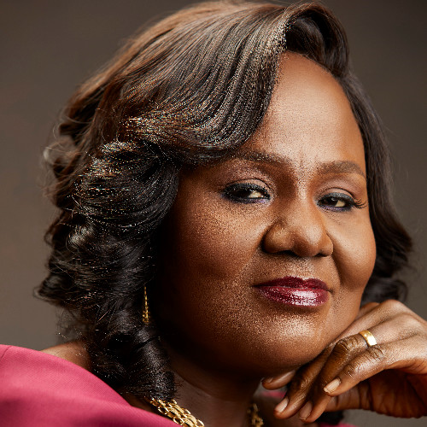
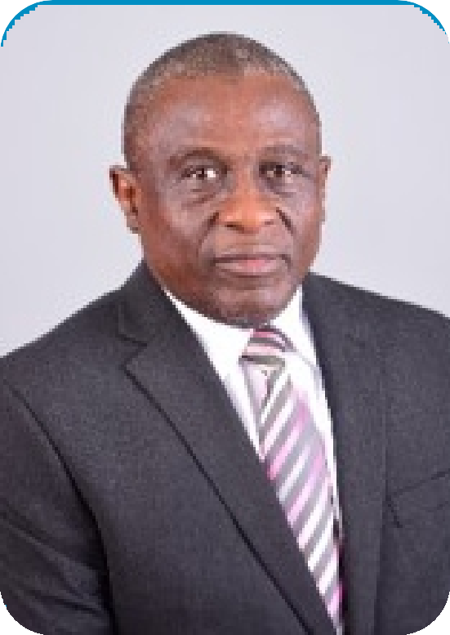
OUR ROLE MODEL FACAULTY LEADRES
Dr. Joseph Mfon
Edem
Dr. Ihuoma Onyearugha
Dr. Tope-Phillips Aikhuemelo
Mfon Joseph Edem is a Seasoned Management Consultant, Procient in Sales & Marketing, Business Development, Customer Service Management, Market Intelligence, Leadership, Entrepreneurship Development, Business Management & Business Insights (Strategy & Growth).
He A faculty member & facilitator in Business & Entrepreneurship Development with Ibadan Business School (IBS). A partner & facilitator at Chilla Consulting (Training of NNPC subsidiaries across Nigeria & other management trainings across Nigeria).
Ihuoma Onyearugha is the immediate past Executive Director of Human Resources & Medical, Chevron Nigeria Limited, a position she held for 7 years (April 2012 – March 2019). She was the only woman on the board of Chevron Nigeria Limited and was also on the boards of Chevron Closed Pension Fund Company and Chevron Savings Plan.
Throughout her 27 years’ service in Chevron Nigeria, she demonstrated admirable leadership and consistent success in the full value chain of talent management in her company.
TP (as he is fondly called) is a pragmatic business leader with a flair for working and winning through teams. Major achievements have come through strategic thinking , strong interpersonal and coaching skills, holding self and others accountable.
He has had varied experiences leading teams across HR, Marketing, and Business Transformation with multinational businesses such as Unilever, Cadbury, Kraft Food, Mondelez, Tiger Brands & FrieslandCampina.
He is currently the Managing Partner of Melos Consulting

Slide 16



WHY US?
At Melos, our values are simple and dene who we are and how we work with our clients and partners. They are titled “PICK” and they guide our actions and interactions with our clients
Professionalism: We strive for the highest standard of professional conduct in everything we do, ensuring the highest standards in service delivery.
Integrity: We conduct business with honesty, transparency, and ethical principles.
Client-Centric: Our clients' success is our priority, and we are dedicated to meeting their unique needs.
Knowledge: We consistently scan the market for new ways of doing things to improve our solutions to client needs and support their success.

Slide 17








PRAGMATIC IMPACTS
CERTIFICATION
ENTERPRISE SKILLS
BUSINESS NETWORKING
FREE MENTORSHIP
LIVE PROJECTS
ROBUST FACULTY

Slide 18

Connect with us.
Plot 1b Rasheed Alatishe Street, Water Front Estate, Magodo Phase 1 Isheri/ Berger
+234 (0) 901 987 9308, +234 (0) 803 473 6690 +234 (0) 809 997 2003
meloventuresltd@gmail.com
linkedin.com/in/melo-ventures-b82183295

